Slide 1

Making Meaning of our Cultural Record
Digital Scholarship Now and in the Future
Dale Storie
Associate University Librarian: Content Management and Discovery

Slide 2
Three questions
Preservation: How do we ensure our digital record persists and remains authentic over time?
Discovery: How do we make our digital record findable and accessible?
Making meaning: How do we analyze and create knowledge from our digital record?

Slide 3
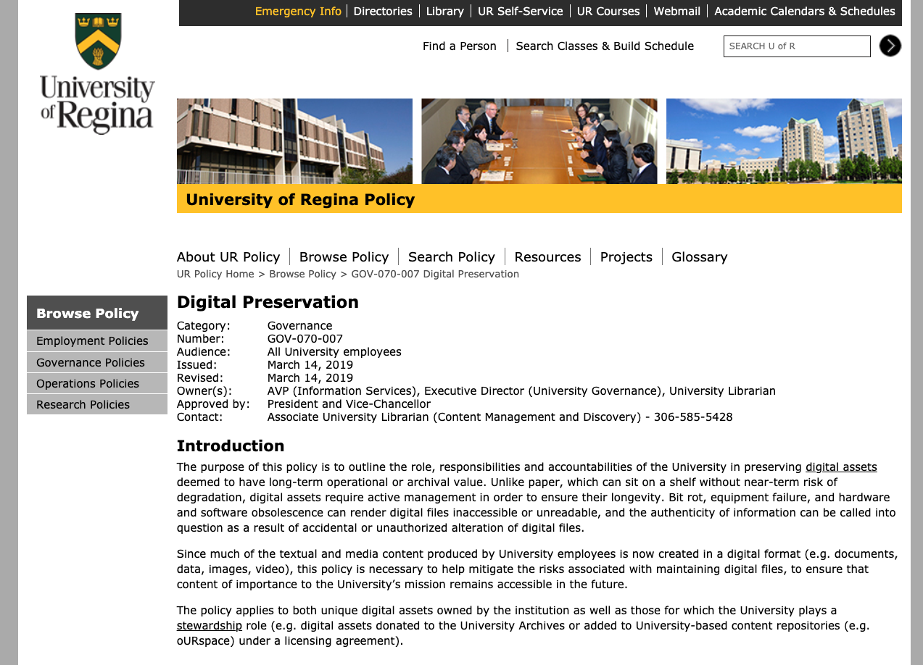

Slide 4
Technical Challenges
Stored in accessible file formats
Stored with appropriate backup and replication
Active monitoring and security to prevent corruption or unauthorized alteration
Accompanied by contextual metadata

Slide 5
Adaptive Challenges
Economic
Organizational
Social

Slide 6
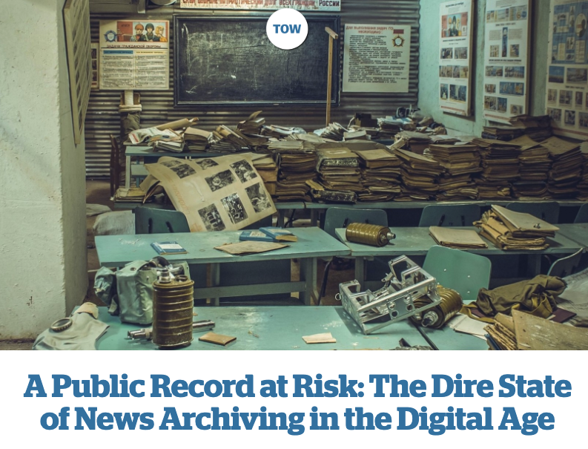
https://www.cjr.org/tow_center_reports/the-dire-state-of-news-archiving-in-the-digital-age.php
Notes:
The majority of the news organizations that participated in this research (19 of 21) had no documented policies for the preservation of their content—nor did they have even informal or ad-hoc archival practices in place.

Slide 7
“The majority of the news organizations that participated in this research (19 of 21) had no documented policies for the preservation of their content—nor did they have even informal or ad-hoc archival practices in place.”

Slide 8
“Don’t get me wrong, I love history but it’s not on my priority list.”

Slide 9
economic pressures & staff layoffs
focus on “what is happening now”
use of complex content management platforms, cloud providers and social media

Slide 10
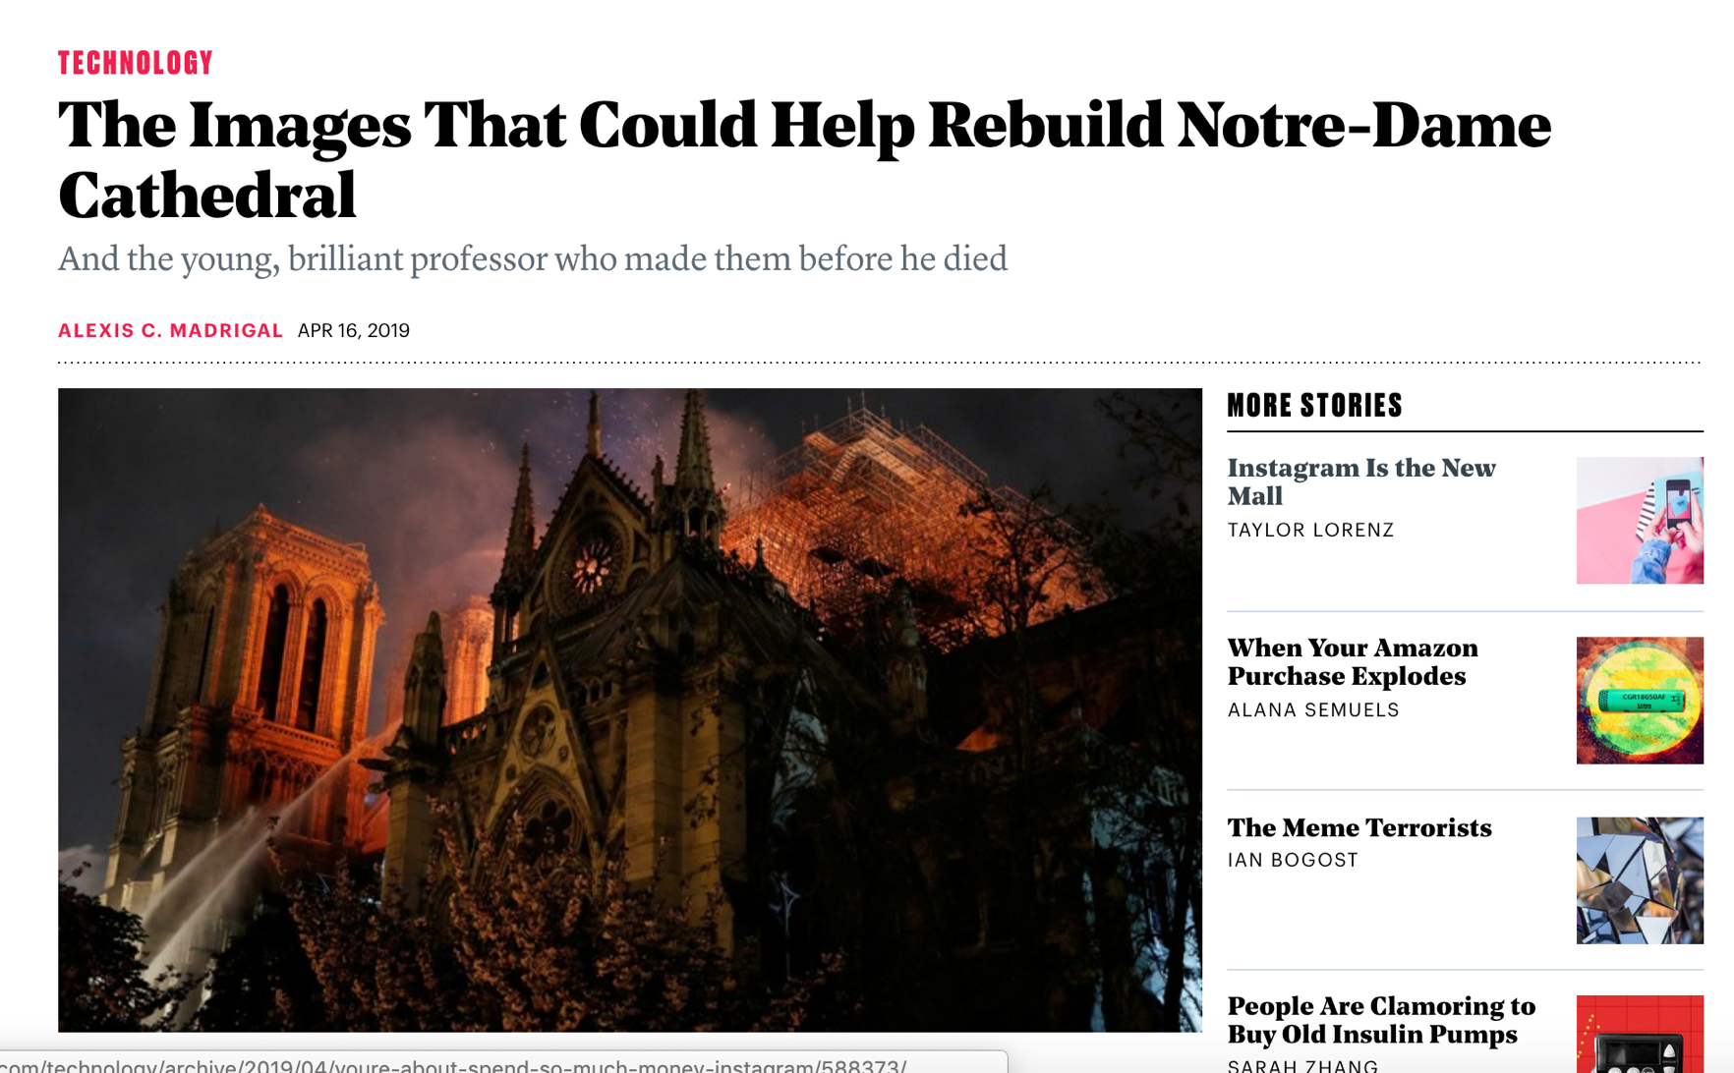
https://www.theatlantic.com/technology/archive/2019/04/laser-scans-could-help-rebuild-notre-dame-cathedral/587230/

Slide 11
“All those data now exist on a single disk, a tiny portal into the past, which is sitting somewhere on Earth. Blaer thought it might be in the hands of Tallon’s students at Vassar. But Ochsendorf thought the data were most likely with the rest of Tallon’s archive, in the possession of his widow, Marie, who held Andrew in her arms as he died.”

Slide 12
Discovery
If the digital record exists, is it accessible?
Is there enough metadata to make the record useful or meaningful?

Slide 13
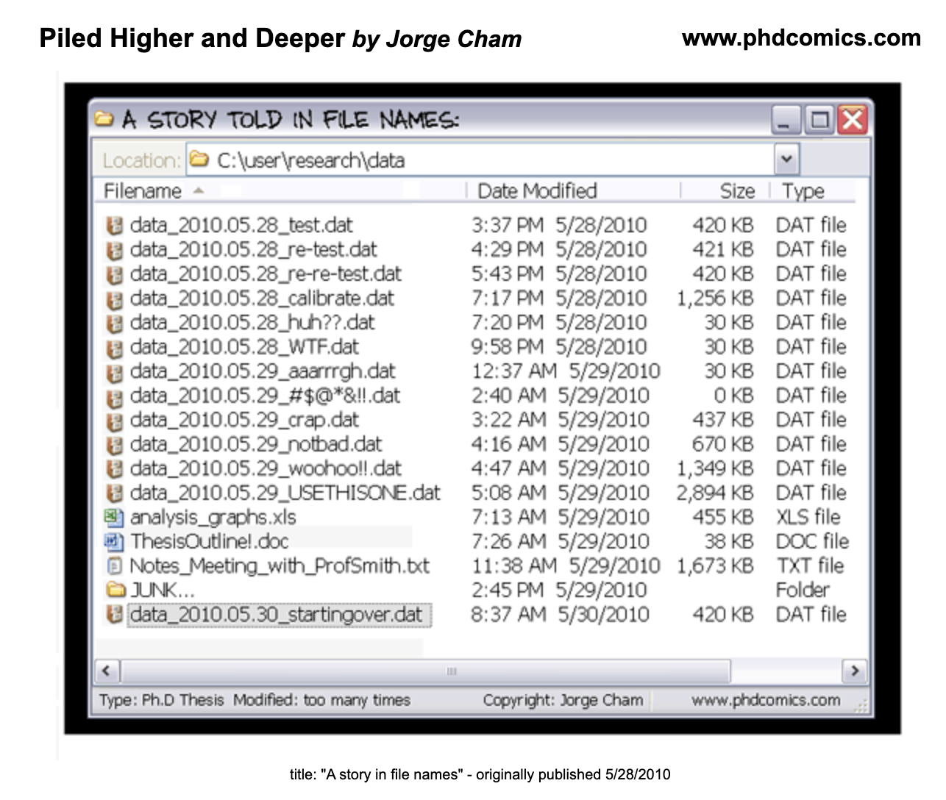

Slide 14
Digital Archives
Lots of data
Not enough context (metadata)
Requires significant human intervention

Slide 15
Digital Archives
What can be made public and what must exist in dark archives?
Reasons for restricting access:
  Commercial
  Legal
  Moral
  Ethical

Slide 16
Metadata is a love note to the future
“Metadata, you see, is really a love note – it might be to yourself, but in fact it’s a love note to the person after you, or the machine after you, where you’ve saved someone that amount of time to find something by telling them what this thing is.”
Jason Scott (2011)

Slide 17
Making meaning
What does scholarship look like when most of our cultural record is digital?
How do we prepare for this future?

Slide 18
Distant Reading
Computational text analysis
Data visualization
Computer vision and machine learning
Linked data and graph databases

Slide 19
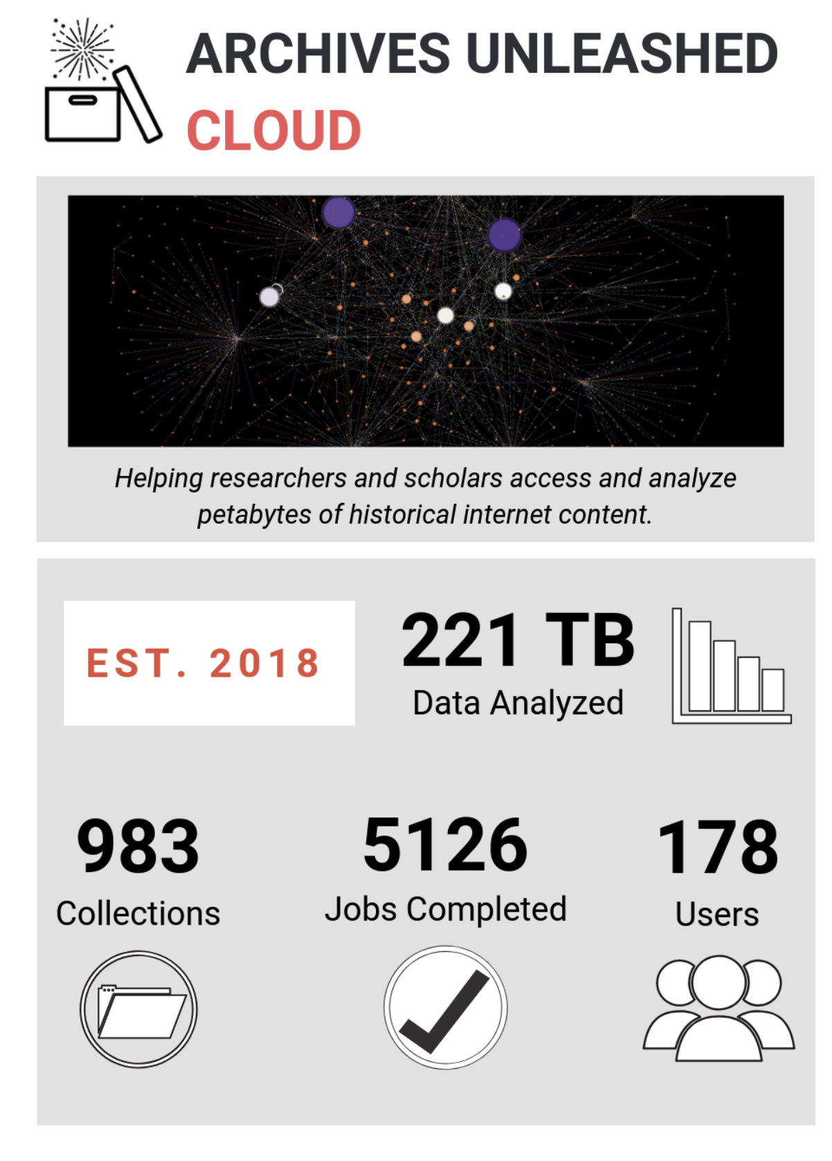
Archives Unleashed
“Today, hundreds of billions of websites preserved at the Internet Archive alone is more archival information than scholars have ever had access to.”
Ian Milligan

Slide 20
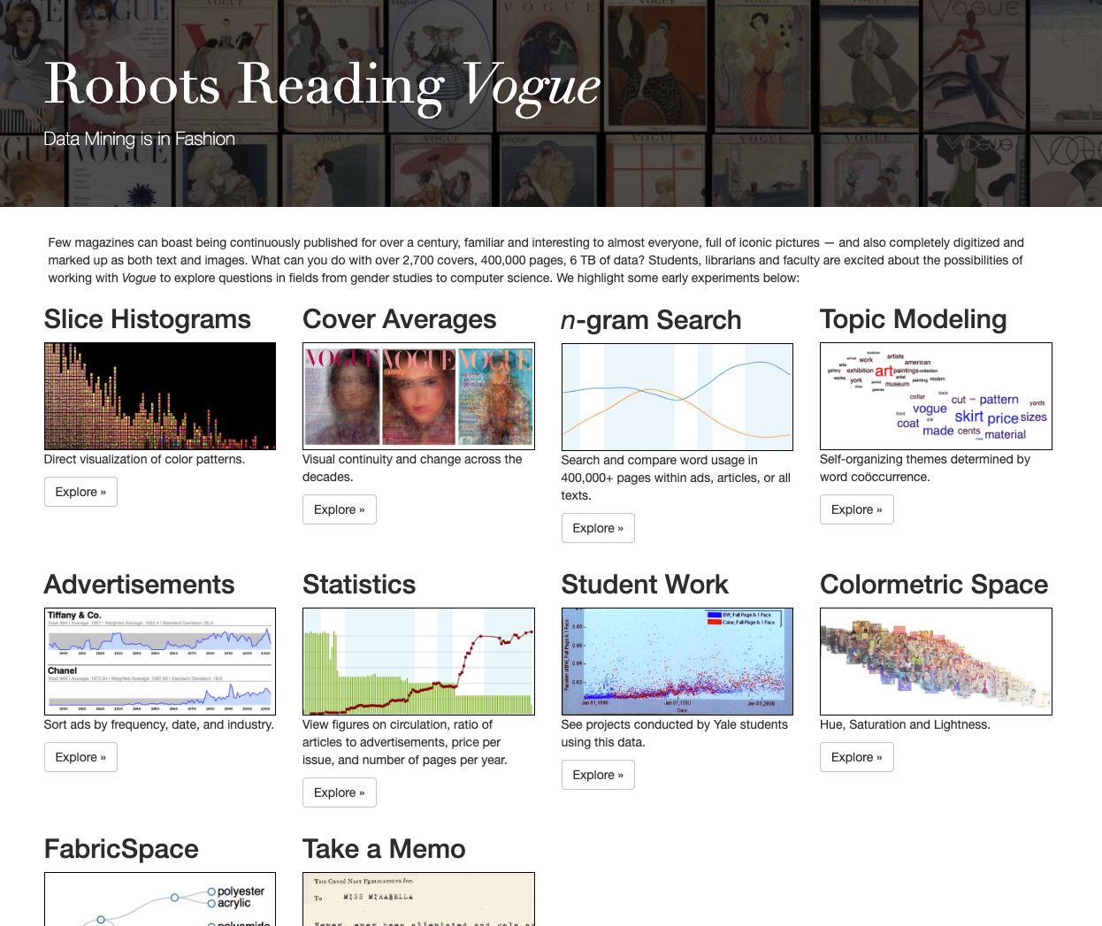

Slide 21
New media for creation
3D scanning and printing
Virtual and augmented reality
Interactive media

Slide 22
When starting a project...
Plan for the end at the beginning
Remember that “metadata is a love note for the future” (Scott 2011)
Get in touch with us when you have questions!

Slide 23
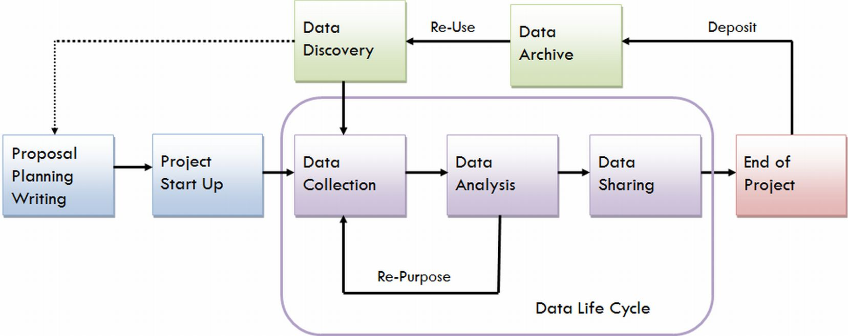
Data Management Planning

Slide 24
Library services
oURspace digital repository - documents, files, and audio/video
Dataverse - for datasets
Data Management Planning
Distributed preservation storage (Westvault, Portico, CLOCKSS)

Slide 25
Thanks!

