Slide 1
Implementing Elastic App Search for Digital Collections
Veronica Ramshaw, Digital Services Librarian
Sanjida Parvin Nishath, Digital Collections Co-op Student
Dale Storie, Associate University Librarian

Slide 2
The University of Regina is situated on Treaty 4 lands with a presence in Treaty 6. These are the territories of the nêhiyawak, Anihšināpēk, Dakota, Lakota, and Nakoda, and the homeland of the Métis/Michif Nation.

Slide 3
Overview
Rationale of the Project
Description of Elasticsearch and App Search
The Co-op student project
Process
Lessons learned

Slide 4
Rationale
Interest in having a more aesthetically-driven presentation of primary source materials (particularly our own archival content)
Less silo-ization for our platforms
Improving search for static sites
Design inspirations:
  UBC Open Collections (https://open.library.ubc.ca/)
  University of Idaho Digital Initiatives (https://www.lib.uidaho.edu/digital/)
  Blackfoot Digital Library (https://www.blackfootdigitallibrary.com/digital/collection/bdl)

Slide 5
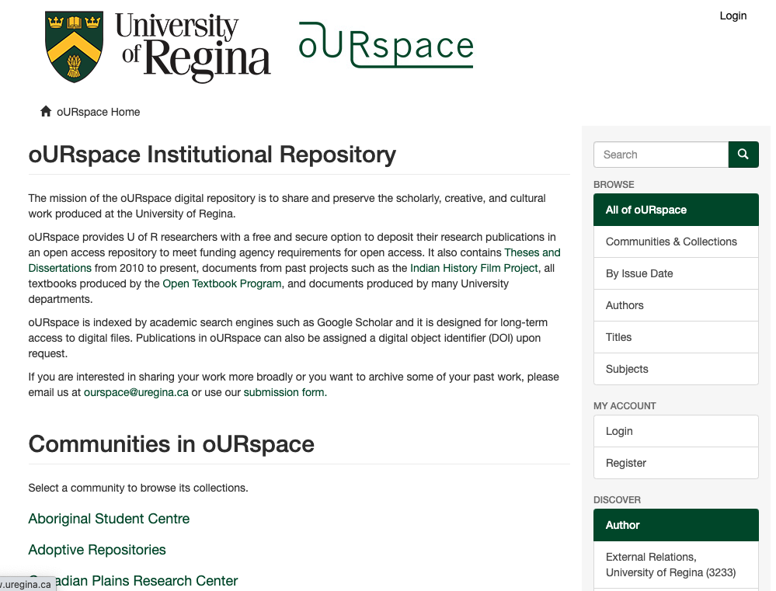
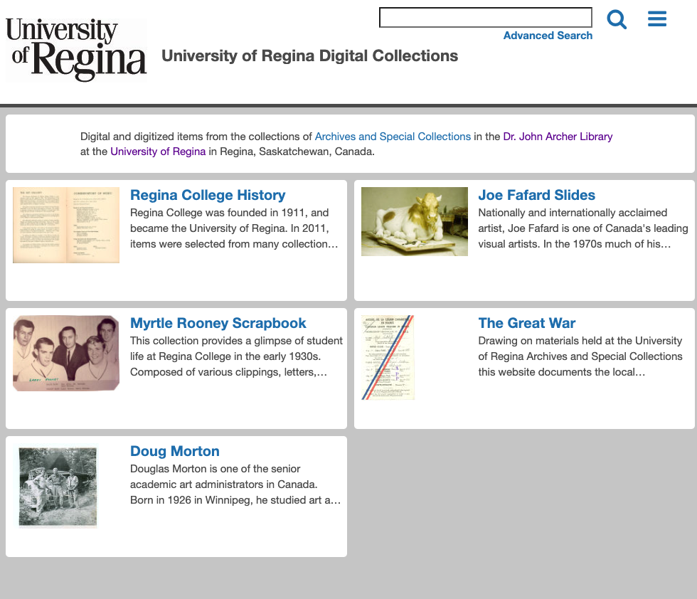
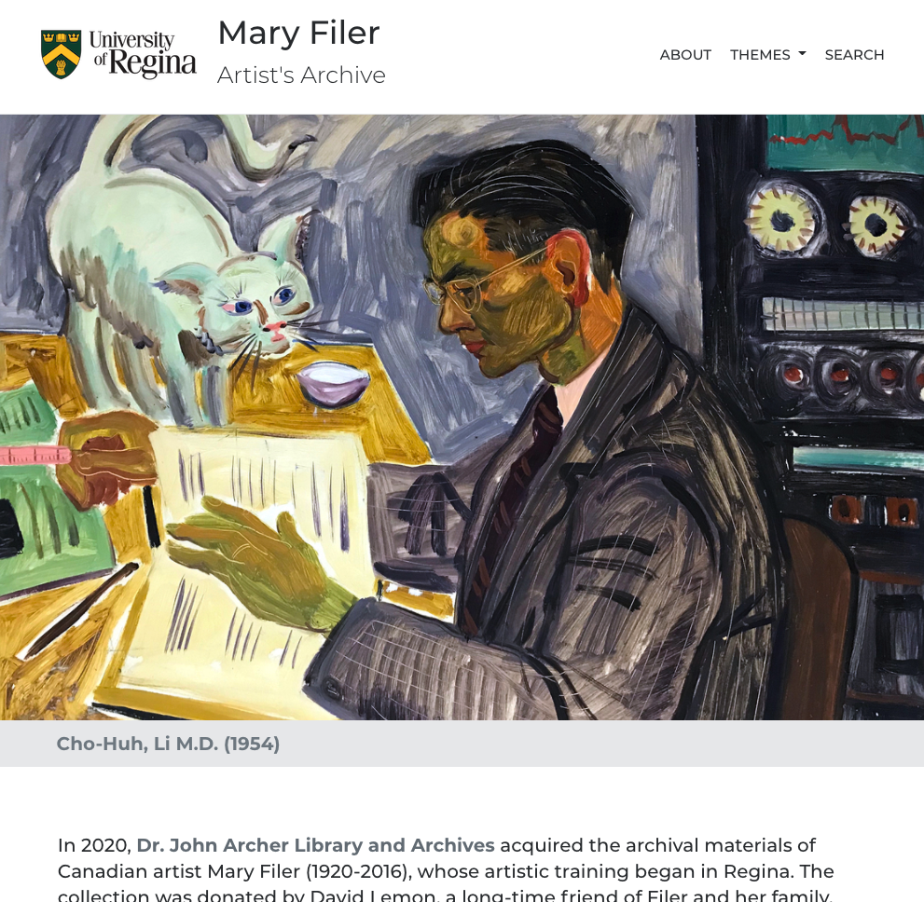
Introduction to uRegina’s collections of digital collections
DSpace
~13000 items
ContentDM
~6000 items
Static sites (w/ Wax)
~500 items
Notes:
In the future, assets will also be on our Kaltura mediaspace instance and an upcoming implementation of AtoM (access to memory)

Slide 6
What is Elasticsearch?
“the world’s leading free and open search and analytics solution”
Available as an free download or hosted option
Elastic App Search
  Offers a pared down / refined set of search functions and APIs
  GUI for loading records, relevance tuning, synonyms, curation
  API for bulk loading, updating, deleting
  Pre-built Reference UI included as a React App

Slide 7
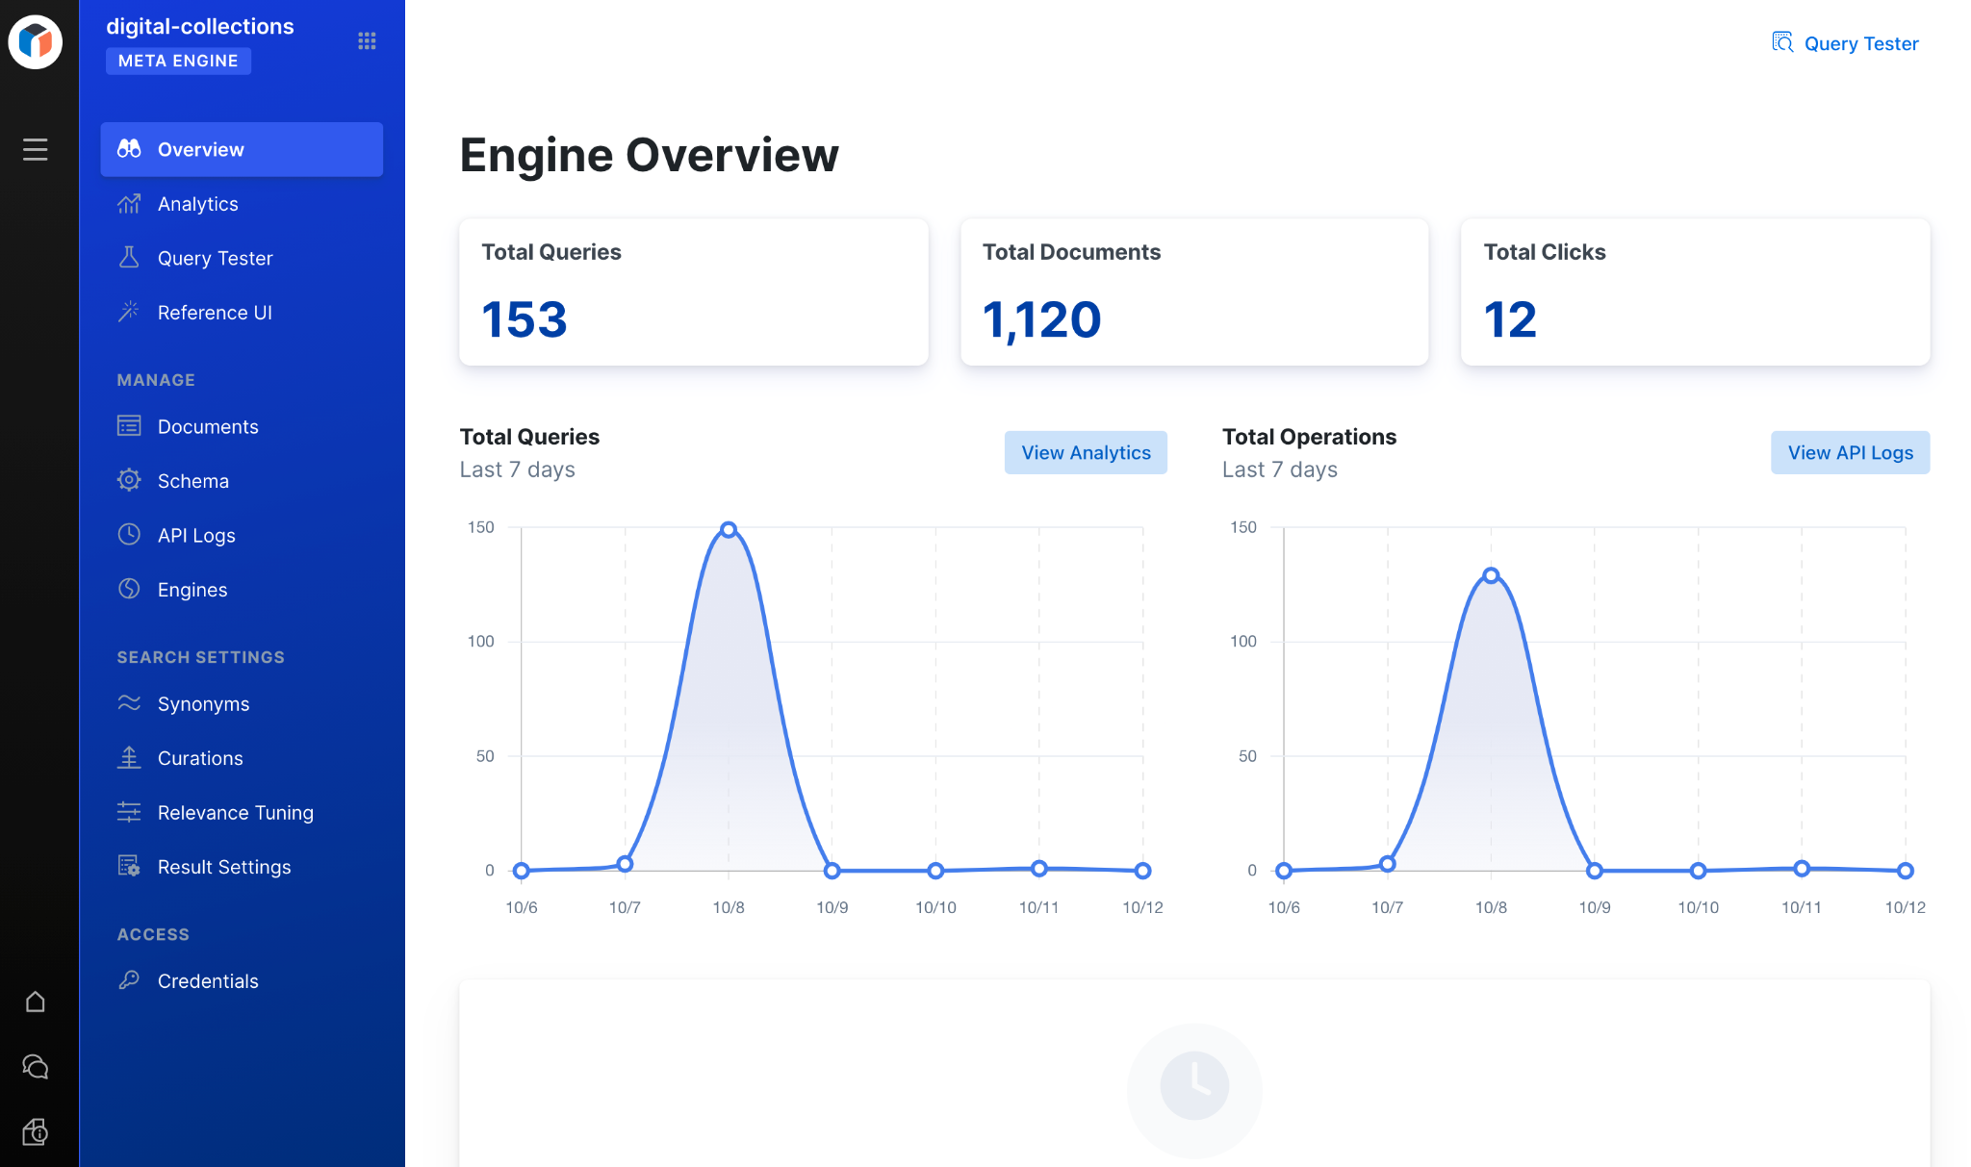

Slide 8
Hosted Elastic App Search
Hosted option by Elastic.co
Choose where it is hosted (AWS, Google Cloud Platform or Microsoft Azure available)
Advertised as costing “as low as $16 USD”
API Requests - Cost per 1000 requests $0.0018
Actual cost for us has been approximately $20-25 USD per month so far ($0.0265 per hour + data transfer)
Notes:
We expect this could go as high as 50-100$ a month

Slide 9
Goals of the Coop Project
~4 month long term
Build a digital collections page with:
  a search interface using the Elastic App Search Reference UI
  a more meaningful access point to our digital collections
Criteria:
  Clear and straight-forward
  Clean aesthetic
  Consistent with institutional visual identity
Learning objectives:
  Working with React
  Organization of information in a digital collections context

Slide 10
Knowledge Going In
HTML, CSS
Javascript
  No pre-existing experience with React
Some prior ElasticSearch experience
  Co-op student had not worked with it before

Slide 11
Process: Build Webpage
Sanjida built a prototype webpage to house the search interface
  Allowed us to finesse the appearance
  Added collection browse functionality
We started with a single engine (maryfiler)
Using the Reference-ui React app, the website customizations from the prototype were integrated into the UI
  Search-ui and app-search-reference-ui-react documentation on github were helpful
  Added accessory pages for “About” and “Contact Us”
  Documented customizations for future replication

Slide 12
Process: Data Processing
ElasticSearch requires .JSONs
Our Static Sites are built on .JSONs
  Only processing needed is to change relative URLs to absolute URLs
CONTENTdm collections export as tab-delimited text
  Remove extraneous fields
  Generate thumbnail URLs
  Rename select headers to match Static Site .JSONs
    All headers needed to be modified to match field name limitations from Elasticsearch (ie/ start with lower case character, no spaces only underscores)
  Convert tab-delimited text to .JSON

Slide 13
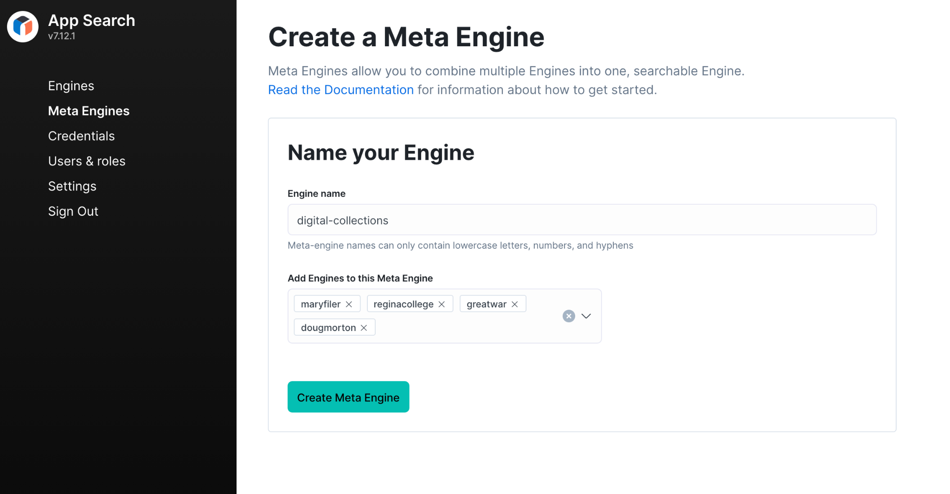
Process: Create Meta-Engine
Upload .JSONs into engines
  One collection = one engine
Creating a Meta-Engine is as easy as picking a name and selecting the Engines to include in it.
Apply Sanjida’s reference-ui customizations
  CSS and changes to the React components to change how results are displayed

Slide 14
Process: Deploy Site
In package.json, set your homepage based on the root of the web server
Compile React search app into static files
Deploy on a standard Apache web server with ‘AllowOverride All’ on the directory

Slide 15
Learning along the way
Setting up a React environment
  Installing NVM, NPM, dependencies
UI design
  CSS
  React.js components
API keys and authenticating

Slide 16
Challenges
Engines vs Meta-engines
  We initially thought we could combine all the metadata into a single engine
  Instead, each set of metadata is its own engine
  Engines are bundled into a meta-engine
GUI limitations: No updating data after upload and no bulk deleting
Extremely inconsistent metadata (especially in older collections)

Slide 17
The End Result
Live Demo: http://165.22.227.74/digitalcollections/

Slide 18
Next Steps
Make use of the synonym feature and relevance tuning in Elasticsearch
Continue adding collections as new collections/static sites are created
  Darke Hall will be the next addition
Evaluate possibility of adding oURspace collections to engines

Slide 19
Thanks to Scott Murray from SILS for his App Search guidance

Slide 20
Thank you!

