Slide 1
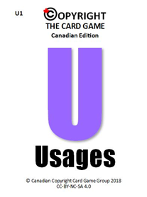
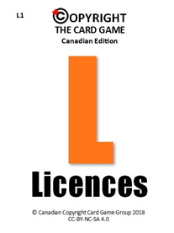
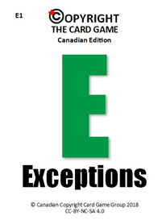
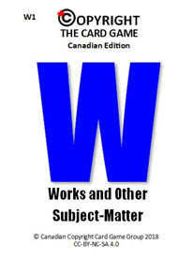



COPYRIGHT THE CARD GAME:
WORKS AND OTHER SUBJECT-MATTER, USAGES, LICENCES, AND EXCEPTIONS
Canadian Edition
Version 1.2 (November 2018)
Adapted by the Canadian Copyright Card Game Group
from Copyright the Card Game v2.0 by copyrightliteracy.org

Slide 2
RUNNING THE CARD GAME
1. It is licensed for non-commercial use only
2. You will need to be familiar with copyright to deal with queries and questions
3. You can train from 6 - 40 people
4. Allow 1 - 3 hours
5. Room set up – teams at tables
6. Customize the scenarios for your own context
7. Keep the pace up and have fun
Notes:
This is guidance for trainers – remove this slide before playing.
The game is currently designed to be played by participants with, at minimum, basic copyright knowledge, though of course it can be adapted for other audiences.
Version 1.2: Exceptions cards have been labelled Basic (with B in the bottom right corner) or Advanced (with A in the bottom right corner).
For games where participants have a limited knowledge of copyright, use Basic exceptions cards only.
For games where participants have more copyright expertise, use both Basic and Advanced exceptions cards.
This game can be played collaboratively (without scoring) or competitively with the suggested scoring rubric below.
Suggested scoring rubric:
Copyright Quiz - warm-up activity - no points attributed
Before the game, host should already have determined the cards expected for each item/scenario (suggested answers for the scenarios are included here)
Round 1 - Works - 2 points if participants get all cards expected for their item (deduct portion of points for the cards that are missed) (to facilitate things, can provide number of expected cards on a post-it since it can vary per item)
Round 2 - Usages - 1 point per card
Round 3 - Licences - 1 point per card
Round 4 - Exceptions - 1 point per card
Round 5 - all cards - 1 point per card
Bonus points are also possible for all rounds if participants can argue that “extra” card(s) apply

Slide 3
DISCLAIMER
The slides are for information purposes only and do not constitute formal legal advice.

Slide 4
OVERVIEW
Time | Activity
10 minutes | Welcome, introductions and warm up quiz
10 minutes | Round 1 - Works and Other Subject-Matter
10 minutes | Round 2 - Usages
10 minutes | Round 3 - Licences
10 minutes | Round 4 - Exceptions
20 minutes | Round 5 – Works and Other Subject-Matter, Usages, Licences, & Exceptions
10 minutes | Wrap up
Notes:
In overview let the participants know that the scoring system is subjective.

Slide 5

INTRODUCTIONS
Introduce yourself to your teammates
Decide on your team name
Give us your team name for the score sheet
Notes:
Think about using Kahoot! or similar tool for the copyright quiz
Provide each team with display cards for team name so that the score-keeper can easily identify the team name.

Slide 6



Slide 7

COPYRIGHT QUIZ
Q. What rights do copyright owners have?
Notes:
What are the main kinds of rights?

Slide 8
COPYRIGHT QUIZ
Q. What rights do copyright owners have?
A. To incentivize and reward creativity, three of the main rights granted to a copyright owner are the sole rights to produce or reproduce, perform in public, and publish a work for the first time.

Slide 9
COPYRIGHT QUIZ
Q. Does copyright protect ideas?

Slide 10
COPYRIGHT QUIZ
Q. Does copyright protect ideas?
A. No, copyright does not protect ideas alone. What is protected is original ways in which ideas are expressed.

Slide 11
COPYRIGHT QUIZ
Q. What tests must a work pass to be protected by copyright?

Slide 12
COPYRIGHT QUIZ
Q. What tests must a work pass to be protected by copyright?
A. For a work to be protected by copyright, it must be ‘original’ and be recorded or ‘fixed’.

Slide 13
COPYRIGHT QUIZ
Q. Who first owns copyright in a new work?

Slide 14
COPYRIGHT QUIZ
Q. Who first owns copyright in a new work?
A. The creator, unless the work was created in the course of employment. In the latter case, the employer is the copyright owner unless there is an agreement to the contrary.
Notes:
You may also wish to mention Crown Copyright

Slide 15
COPYRIGHT QUIZ
Q. What sort of content does copyright protect?

Slide 16
COPYRIGHT QUIZ
Q. What sort of content does copyright protect?
A. Copyright covers all original productions in the literary, scientific and artistic domains (e.g., text, images, songs, film, performers’ performances).

Slide 17
COPYRIGHT QUIZ
Q. Do copyright works need to be registered?

Slide 18
COPYRIGHT QUIZ
Q. Do copyright works need to be registered?
A. No, copyright protection is automatic as soon as the work is ‘fixed’. But registering copyright with the Canadian Intellectual Property Office is an option.

Slide 19
COPYRIGHT QUIZ
Q. Does a work need to marked with a “©” in order to be protected by copyright?

Slide 20
COPYRIGHT QUIZ
Q. Does a work need to marked with a “©” in order to be protected by copyright?
A. No. In Canada a copyright work doesn’t need a “©” to be protected, but it helps to indicate that it is protected.

Slide 21
COPYRIGHT QUIZ
Q. What is the legislation?

Slide 22
COPYRIGHT QUIZ
Q. What is the legislation?
A. The Copyright Act, as amended and revised

Slide 23
COPYRIGHT: THE GAME
Notes:
Note that the rounds played in with these slides do not currently use the Risk suit but the cards are included in the deck and that it could easily be incorporated in Round 5, time allowing, for more nuanced and true-to-life play, since copyright decisions almost always involve some degree of risk assessment.

Slide 24
THE RULES
Each round will focus on one ‘suit’
Each team will have one deck of cards
Each team must nominate a card handler
Teams should confer and agree on answers
Answers to the scenarios are given by selecting the cards
Notes:
Let teams know that they should lay out the suit they are playing on the table.

Slide 25
Works and Other Subject-Matter

Slide 26
WHY CONSIDER TYPES OF COPYRIGHT WORKS AND OTHER SUBJECT-MATTER?
W
Works and Other Subject-Matter
Different durations
Different layers of rights
Different owners within content
Different licences
Some exceptions work-specific

Slide 27







COPYRIGHT WORKS AND OTHER SUBJECT-MATTER
W
Works and Other Subject-Matter
Literary
Artistic
Musical
Dramatic
Anonymous/Pseudonymous
Unpublished
Posthumous
Notes:
Take a moment to review the cards

Slide 28





COPYRIGHT WORKS AND OTHER SUBJECT-MATTER
W
Works and Other Subject-Matter
Public Domain
Communication Signal
Sound Recording
Moral Rights
Performer’s Performance
Non-Qualifying
Work related
Notes:
Public domain: Generally, copyright expires 50 years after the death of the author. However, important changes are coming. The ratification of the United States-Mexico-Canada-Agreement (reached Sept. 30, 2018) will extend the duration of copyright by 20 years (i.e. life + 70 years). Final ratification and implementation of the agreement are pending. Changes to the Copyright Act may not take effect until after 2020.

Slide 29
ROUND 1
W
Works and Other Subject-Matter
Use your “Works and Other Subject-Matter” cards to identify what types of works or other subject-matter are in the object your team has been given.
Notes:
Objects can include: DVDs, musical birthday cards, books (in and out of copyright), CDs, Software etc.
Each team is given a different item. Let the audience know that the objects are only for this round.

Slide 30
Usages
Notes:
Use is the act you are performing with the copyright work

Slide 31
WHY CONSIDER TYPES OF COPYRIGHT USAGE?
U
Usages
They are the economic rights as defined in the Copyright Act
The rights must be ‘mapped’ onto any activity to understand licences and exceptions available

Slide 32






COPYRIGHT USAGES
U
Usages
Copying
Issuing Copies to the Public
Rental or Lending
Public Performance
Communication to the Public
Adaptation
Notes:
Here are the usages, make sure to take a look at them all

Slide 33
ROUND 2
U
Usages
Using your “Usages” cards, decide what types of usage apply in the following scenario.

Slide 34
ROUND 2
U
Usages
What types of usages apply?
1. A blogger uploads an image to his blog.

Slide 35
ROUND 2
U
Usages
What types of usages apply?
1. A blogger uploads an image to his blog.
Communication to the public
Copying

Slide 36
Licences

Slide 37
WHY CONSIDER TYPES OF COPYRIGHT LICENCE?
L
Licences
  Can effectively provide zero risk
  May already have paid for them
They all involve limitations
  Not carte blanche
  Relationship with exceptions

Slide 38






COPYRIGHT LICENCES
L
Licences
Audio Cine/ Criterion Pictures
Library Licensed Resources
Creative Commons
Access Copyright/Copibec
Copyright Clearance Center
SOCAN

Slide 39






COPYRIGHT LICENCES
L
Licences
Crown Copyright
Copyright Owner
Website Terms & Conditions
Unlocatable Copyright Owners
You Own the Copyright
Work Produced by Employees
Licence related

Slide 40
ROUND 3
L
Licences
Using your “Licences” cards, decide what types of licences apply in the following scenario.

Slide 41

ROUND 3
L
Licences
What types of licence might apply?
1. A student group wants to screen Black Panther as part of their orientation week activities

Slide 42
ROUND 3
L
Licences
What types of licence might apply?
1. A student group wants to screen Black Panther as part of their orientation week activities
Audio Cine/Criterion

Slide 43
Exceptions
Notes:
In the Copyright Act there are exceptions to copyright infringement.

Slide 44
FAIR DEALING
E
Exceptions
Allows limited copying and use of works
for the purpose of research, private study, education, parody, or satire.
6 factors - CCH v LSUC, [2004] 1 SCR 339
the purpose of the dealing (Is it commercial or research/educational?)
the amount of the dealing (How much was copied in relation to the whole?)
the character of the dealing (What was done with the work? Was it an isolated use or an ongoing, repetitive use? How widely was it distributed?)
alternatives to the dealing (Was the work necessary for the end result? Could the purpose have been achieved without using the work?)
the nature of the work (Is there a public interest in its dissemination? Was it previously unpublished?)
the effect of the dealing on the original work (Does the use compete with the market of the original work?)

Slide 45






KEY EXCEPTIONS TO COPYRIGHT
E
Exceptions
S.29 Fair Dealing (B)
S.29.1 Fair Dealing: Criticism or Review (B)
S.29.2 Fair Dealing: News Reporting (B)
S.29.21 Non-Commercial User-Generated Content (B)
S.29.22 Reproduction for Private Purposes (A)
S.29.23 Reproduction for Later Listening or Viewing (B)
Notes:
Exceptions cards have been labelled Basic (with B in the bottom right corner) or Advanced (with A in the bottom right corner).
If you are playing with only the B deck, you may wish to remove the A exceptions from these slides

Slide 46






KEY EXCEPTIONS TO COPYRIGHT
E
Exceptions
S.20.24 Backup Copies (A)
S.29.4 Reproduction for Instruction (A)
S.29.5 Performances (B)
S.29.6 News and Commentary (A)
S.29.7 Reproduction of Broadcast (A)
S.30 Literary Collections (A)

Slide 47






KEY EXCEPTIONS TO COPYRIGHT
E
Exceptions
S.30.01 Communication of Lessons by Telecommunication (B)
S.30.04 Work Available Through Internet (B)
S.30.1 Management and Maintenance of Collections (B)
S.30.2 Research or Private Study (B)
S.30.21 Works Deposited in Archive (A)
S.30.3 Machines Installed in Educational Institutions, Libraries, Archives, and Museums (B)

Slide 48






KEY EXCEPTIONS TO COPYRIGHT
E
Exceptions
S.30.6 Computer Programs (A)
S.30.61 Interoperability of Computer Programs (A)
S.30.62 Encryption Research (A)
S.30.62 Security (A)
S.30.7 Incidental Inclusion (A)
S.30.71 Temporary Reproductions (A)

Slide 49




KEY EXCEPTIONS TO COPYRIGHT
E
Exceptions
S.32 Reproduction in Alternate Format (B)
S.32.2 Miscellaneous Acts (A)

Slide 50
ROUND 4
E
Exceptions
Using your “Exceptions” cards, decide what types of exceptions apply in the following scenario.

Slide 51
ROUND 4
E
Exceptions
What types of exceptions might apply?
1. An instructor is conducting a distance education course that takes place fully online. The instructor has created lecture slides, which include some copyright-protected images from the internet, that they would like to share with the students in the course through a password-protected LMS.

Slide 52
ROUND 4
E
Exceptions
What types of exceptions might apply?
S. 30.04 Works available through the Internet (B)
S. 29 Fair Dealing (B)
S. 30.01 Communication of Lessons by Telecom (B)

Slide 53
ROUND 5
The Rules:
Consider the following scenario within your teams
Play the relevant ‘Works’, ‘Usage’, ‘Licences’ and ‘Exceptions’ cards
Notes:
Here is where you could incorporate use of the numbered Risk cards, each team having the opportunity to make an assertion about the assessed Risk of their proposed solution. If you choose to have participants use the Risk cards, you may add the image of the number you deem appropriate (from 0-5) on the answer slide (55) or for additional scenarios you wish to include in your game play.

Slide 54
ROUND 5
A Fine Arts professor wants to create a 3D printed version of a sculpture that is permanently on display in a public sculpture garden. The creator of the sculpture is still alive. The researcher would like to display the 3D printed version of the sculpture during her academic conference presentation, and also display images of the original sculpture during the presentation. There is a fee for attending the conference, which will be attended primarily by artists and fine arts researchers/academics.
Notes:
Exceptions cards have been labelled Basic (with B in the bottom right corner) or Advanced (with A in the bottom right corner).
If you are playing with only the Basic exceptions, you should modify the next slide to remove the Advanced exception: S. 32.2(1) Miscellaneous Act (“Allows a person to (b) make a rendering, photograph, or film of (i) an architectural work or (ii) a sculpture or work of artistic craftsmanship that is permanently situated in a public place or building...)

Slide 55







W
Works and Other Subject-Matter
U
Usages
3D Printing
L
Licences
E
Exceptions
Notes:
Works: Artistic Work, Moral Rights
Usages: Copying, Public Performance (the professor’s presentation)
Licence: Copyright Owner (permission needed for displaying the 3D copy at the conference?)
Exception: S. 32.2(1) Miscellaneous Act (“Allows a person to (b) make a rendering, photograph, or film of (i) an architectural work or (ii) a sculpture or work of artistic craftsmanship that is permanently situated in a public place or building...), maybe S. 29.1 Fair Dealing: Criticism or Review (if the sculpture was copied/displayed for the purpose of criticism or review)

Slide 56
Canadian Copyright Card Game Group’s 3 TOP TIPS
1. First start by considering the works and other subject-matter and usages
2. Then consider licences and if there are none that apply, look at exceptions.
3. You will always need to make a risk assessment.

Slide 57
LINKS
Copyright Act
Canadian Intellectual Property Office
University Copyright Guides (CARL)
Copyright Matters! (CMEC)
Notes:
Christina

Slide 58
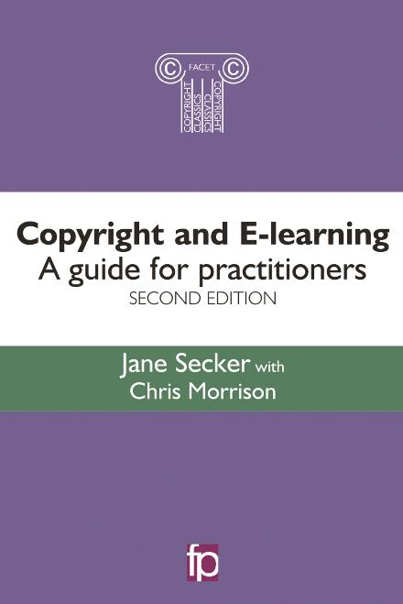
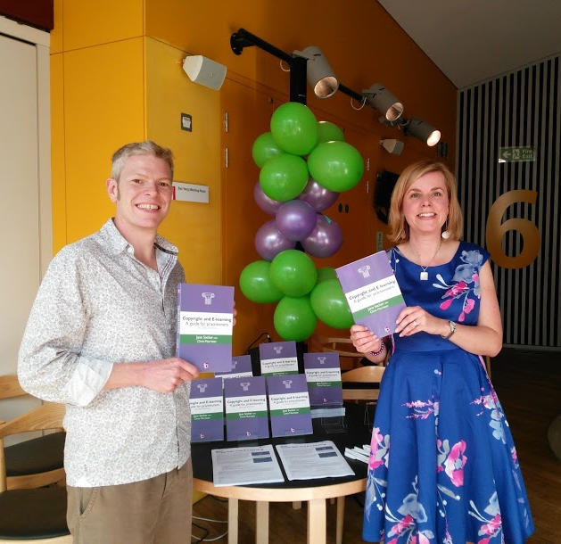

FURTHER READING
@cbowiemorrison @jsecker
Chapter 6 available for free download (includes case study on the card game)
ukcopyrightliteracy.wordpress.com
Notes:
Christina

Slide 59


CREDITS
This material is adapted for a Canadian audience from Copyright the Card Game v2.0
© Chris Morrison and Jane Secker (@UKCopyrightLit) 2017 and is available for reuse under a Creative Commons Attribution- NonCommercial-ShareAlike 4.0 licence.
UK Copyright Literacy: http://copyrightliteracy.org
The following slides and accompanying cards with changes are (apart from any images contained within):
© Canadian Copyright Card Game Group 2018 and are available under a Creative Commons Attribution-NonCommercial-Share Alike 4.0 licence.
Icons from The Noun Project (thenounproject.com), NounPro royalty-free license, attribution not required.

Slide 60
CREDITS, CHANGES and ADDITIONS
The following changes and additions are © Canadian Copyright Card Game Group 2018 and are available under a Creative Commons Attribution-NonCommercial-ShareAlike 4.0 licence.
Cards:
Replaced UK information with the applicable Canadian content.
Changed the design and logo of the cards.
Replaced the icons with openly licensed icons from The Noun Project (NounPro royalty-free license, attribution not required)
Slight modification of colours.
Slides:
Title Slide
Added new card images, icons, and author credits.
Disclaimer Page
Removed references to UK law and contact information.
Overview Page
Changed time length of the game.

Slide 61
Copyright Quiz
Revised some questions to reflect Canadian law.
Works and Other Subject-Matter
Added Other Subject-Matter and replaced UK examples with Canadian content.
Round 1
Slight modification of wording to reflect Canadian law.
Why Consider Types of Copyright Usage.
Slight modification of wording to reflect Canadian law.
Round 2
Replaced Usage scenario with a different example.
Removed 3 other Usage slides.
Copyright Licences
Replaced UK licences with Canadian copyright licenses.
Round 3
Replaced Licence scenario with a different example.
Removed 2 Licence slides.
Exceptions
Revised Fair Dealing slide to reflect Canadian law.
Key Exceptions to Copyright
Changed UK exceptions to Canadian exceptions.
Removed copyright override and non-contractual overrides slides.
Added scenario.
Round 4
Replaced Round 4 scenario with a different example.
Slide 46
Removed Copyright Licensing Agency slide.
Slides 45-47
Changed slides to reflect Canadian version of the game.

