Slide 1
Unpaywall
Dale Storie
Associate University Librarian
University of Regina Library
April 26, 2019

Slide 2
What is Unpaywall?
A project from ImpactStory, a non-profit run by Heather Piwowar and Jason Priem
ImpactStory is ”dedicated to building tools to help make scholarly research more open, accessible and reusable.”
Notes:
Piwowar – engineering and bioinformatics
Priem – information science PhD

Slide 3
What is Unpaywall?
“An open database of 23,034,149 free scholarly articles.”
Content is harvested from 60,000 publishers and repositories
Completely legal!
Similar to the Open Access Button (which also includes Unpaywall data), except with different data options
Notes:
Piwowar – engineering and bioinformatics
Priem – information science PhD

Slide 4
How to use Unpaywall
Find open access copies quickly
  Browser extension
  Integration with discovery systems, link resolvers, and databases
Conduct informetrics research on open access coverage

Slide 5
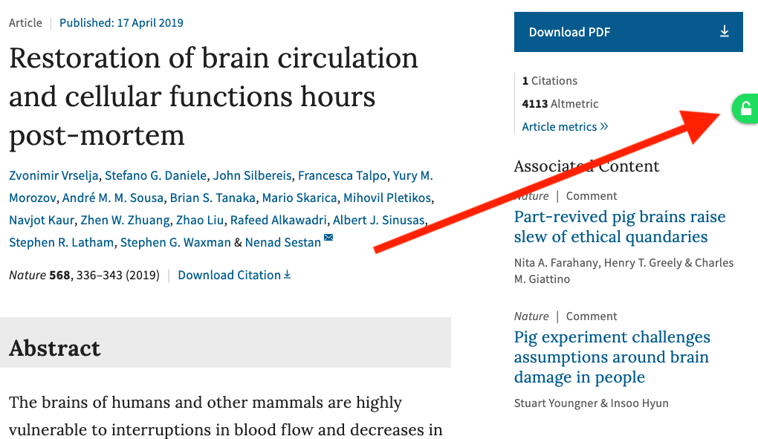
Chrome/Firefox Extension

Slide 6
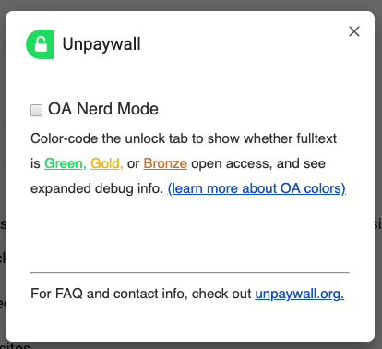
Chrome/Firefox Extension

Slide 7
Add it to your link resolver
SFX, 360, Alma/Primo
https://knowledge.exlibrisgroup.com/Primo/Community_Knowledge/How_to_–_Add_an_Unpaywall_General_Electronic_Service_to_Alma%2C_for_Open_Access_links_in_Primo
Anyone using this?
https://casls-primo-prod.hosted.exlibrisgroup.com/primo-explore/fulldisplay?docid=TN_sciversesciencedirect_elsevierS0264-410X(17)31093-9&context=PC&vid=01CASLS_REGINA&search_scope=default_scope&tab=default_tab&lang=en_US

Slide 8
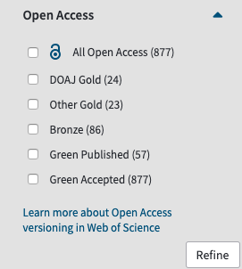
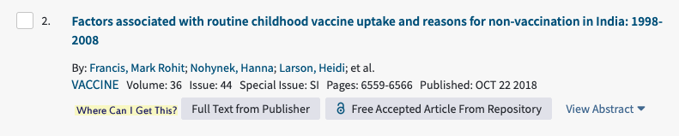
Integration with databases
Web of Science (Dec. 2017)
Dimensions (Jan. 2018)
Scopus (July 2018)
Zotero (Oct. 2018)

Slide 9
Get your repository or journal indexed
“Unpaywall finds OA content in many ways, including using data from open indexes like Crossref and DOAJ where it exists. However, the majority of our OA content comes from independently monitoring over 50,000 unique online content hosting locations, including Gold OA journals, Hybrid journals, institutional repositories, and disciplinary repositories.”

Slide 10
Who is using it?
As of Feb. 2019:
  200,000 users of the browser extension
  1600 libraries with SFX integration
  1 million papers delivered every day
http://blog.impactstory.org/unpaywall-200k-users/

Slide 11
OA research
Piwowar H, Priem J, Larivière V, Alperin JP, Matthias L, Norlander B, Farley A, West J, Haustein S. 2018. The state of OA: a large-scale analysis of the prevalence and impact of Open Access articles. PeerJ 6:e4375 https://doi.org/10.7717/peerj.4375

Slide 12
Data Sources
Simple Query Tool – web-based tool to look up 1000 DOIs at once, receive via email
REST API – query one-by-one
Full database snapshot on-demand (85 GB)
Ongoing data feed

Slide 13
Questions?

