Slide 1
Community-Driven Digital Preservation with COPPUL
Dale Storie
Mark Vajcner
James Holobetz

Slide 2
COPPUL
22 University Libraries from Manitoba, Saskatchewan, Alberta and British Columbia
Purpose is to “leverage our collective expertise, resources, and influence”
Digital preservation efforts beginning in 2007

Slide 3
Digital Stewardship Network Steering Committee
Corey Davis, COPPUL Digital Preservation Coordinator (ex officio)
Jordan Bass, University of Manitoba
Ben Hyman, Vancouver Island University
Mark Jordan, Simon Fraser University
Valla McLean, MacEwan University
Dan Mirau, Concordia University of Edmonton
Todd Mundle, Kwantlen Polytechnic University
Gabrielle Prefontaine, University of Winnipeg
Susan Powelson, University of Calgary
Dr. Umar Qasim, University of Alberta
Bronwen Sprout, University of British Columbia
Dale Storie, University of Regina
Kristina McDavid, COPPUL Executive Director (ex officio)

Slide 4
What is Digital Preservation?
“The series of managed activities, policies, strategies and actions to ensure the accurate rendering of digital content for as long as necessary, regardless of the challenges of media failure and technological change.”
National Digital Stewardship Alliance Glossary (https://ndsa.org/glossary/)

Slide 5
Technical Challenges
Storage Infrastructure
Data Integrity and security
Constantly changing hardware and software
Complex digital platforms
Staggering amount of content created

Slide 6
NDSA Levels of Preservation
Storage and Geographic Location
File Fixity and Data Integrity
Information Security
Metadata
File Formats
https://ndsa.org/activities/levels-of-digital-preservation/

Slide 7
Adaptive Challenges
Economic
Organizational
Political
Social
Ron Heifetz - http://changetheorists.pbworks.com/w/page/15475038/Ron%20Heifetz

Slide 8
Some Examples

Slide 9
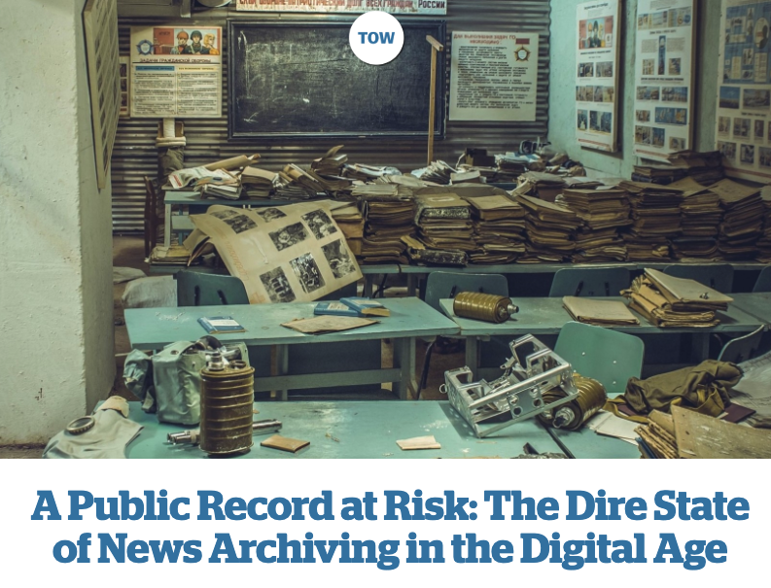
https://www.cjr.org/tow_center_reports/the-dire-state-of-news-archiving-in-the-digital-age.php
Notes:
The majority of the news organizations that participated in this research (19 of 21) had no documented policies for the preservation of their content—nor did they have even informal or ad-hoc archival practices in place.

Slide 10
“The majority of the news organizations that participated in this research (19 of 21) had no documented policies for the preservation of their content—nor did they have even informal or ad-hoc archival practices in place.”

Slide 11
economic pressures & staff layoffs
focus on “what is happening now”
use of complex content management platforms, cloud providers and social media

Slide 12
“…almost all of the participants shared with us personal stories and experiences of losing information.”

Slide 13
“Don’t get me wrong, I love history but it’s not on my priority list.”

Slide 14



Commercial digital platforms
productivity and sharing
long term archiving
when the money runs out

Slide 15
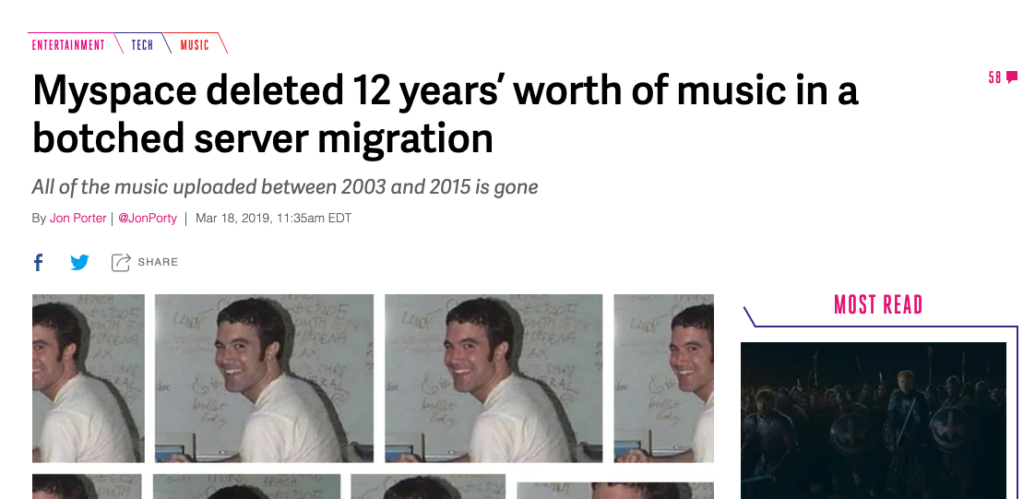

Slide 16
An academic example

Slide 17
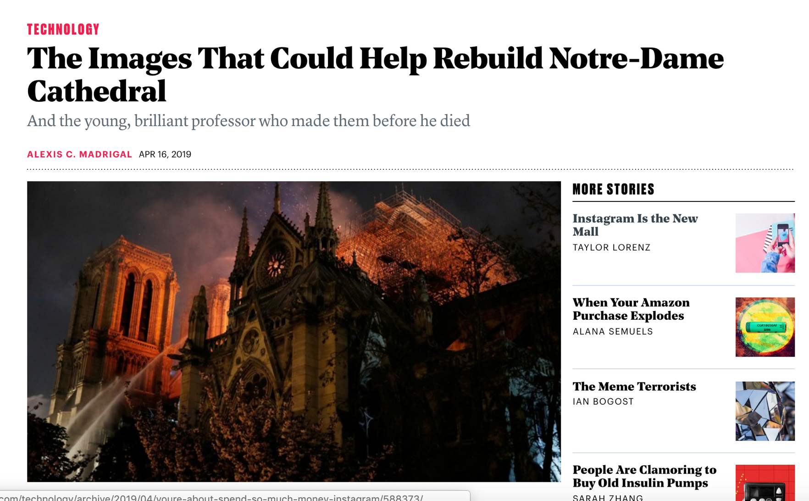

Slide 18
“Tallon and Blaer’s laser data consist of 1 billion data points, structured as “point clouds,” which software can render into images of the three-dimensional space. Stitch them together, inside and out, map the photographs onto the precise 3-D models, and you have a full digital re-creation of incredible detail and resolution.”
- The Atlantic

Slide 19
“All those data now exist on a single disk, a tiny portal into the past, which is sitting somewhere on Earth. Blaer thought it might be in the hands of Tallon’s students at Vassar. But Ochsendorf thought the data were most likely with the rest of Tallon’s archive, in the possession of his widow, Marie, who held Andrew in her arms as he died.”

Slide 20
Data management planning
Help content creators think about managing data proactively throughout the entire process
Provide options for archiving data when the project is done
Policies to encourage this behaviour

Slide 21
Digital preservation requires…
Planning and prioritization
Resource allocation
Sustainable solutions
Capacity building and collaboration

Slide 22
COPPUL Digital Preservation Services
Focused on:
Sustainability
Open-source software
Non-commercial hosting
Collaboration
The benefits of COPPUL's digital preservation services

Slide 23
Technical Details

Slide 24
LOCKSS
“Lots of Copies Keeps Stuff Safe”
An open source, library-led preservation software system

Slide 25
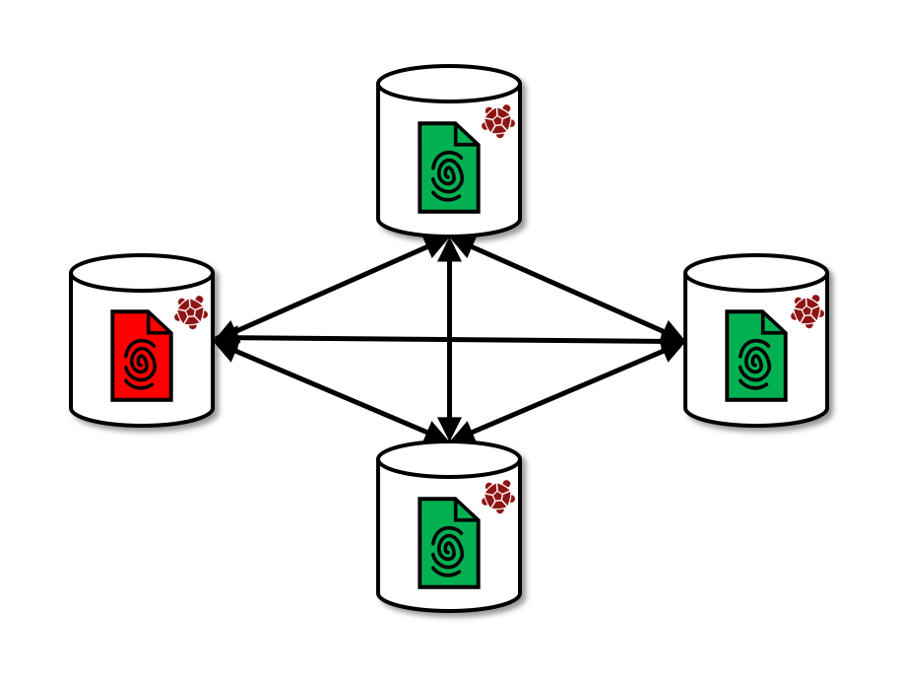
LOCKSS
“Lots of Copies Keeps Stuff Safe”
N. Taylor (2019). https://bibbase.org/network/publication/taylor-lotsofchecksumskeepstuffsafer-2019

Slide 26
COPPUL Private LOCKSS Network
Begun in 2007
8 institutions to start expanded to 11
Each institution hosted a LOCKSS box.

Slide 27
COPPUL PLN Challenges
Difficult to get content into the network
Only institutions who hosted a LOCKSS box could use the service
Large number of nodes added complexity and increased costs

Slide 28
COPPUL WestVault (2018)
Drag and drop deposit through web interface

Slide 29
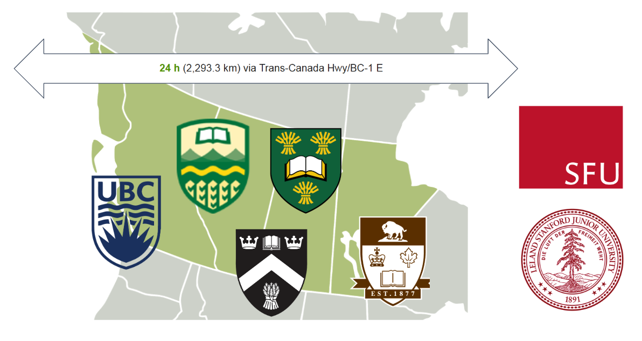

Slide 30
Other services
Preservation processing (Archivematica)
Web Archiving (Archive-it)
Digital Repositories (Arca and Dataverse)

Slide 31
Addressing the adaptive challenges
If you build it, will they come?
12 institutions signed up to deposit content
Focus on capacity building at an institutional level

Slide 32
Communicating risk
Get stuff off a hard drive and into ANY managed storage system – whether institutional or cloud
Avoid a single point of failure

Slide 33
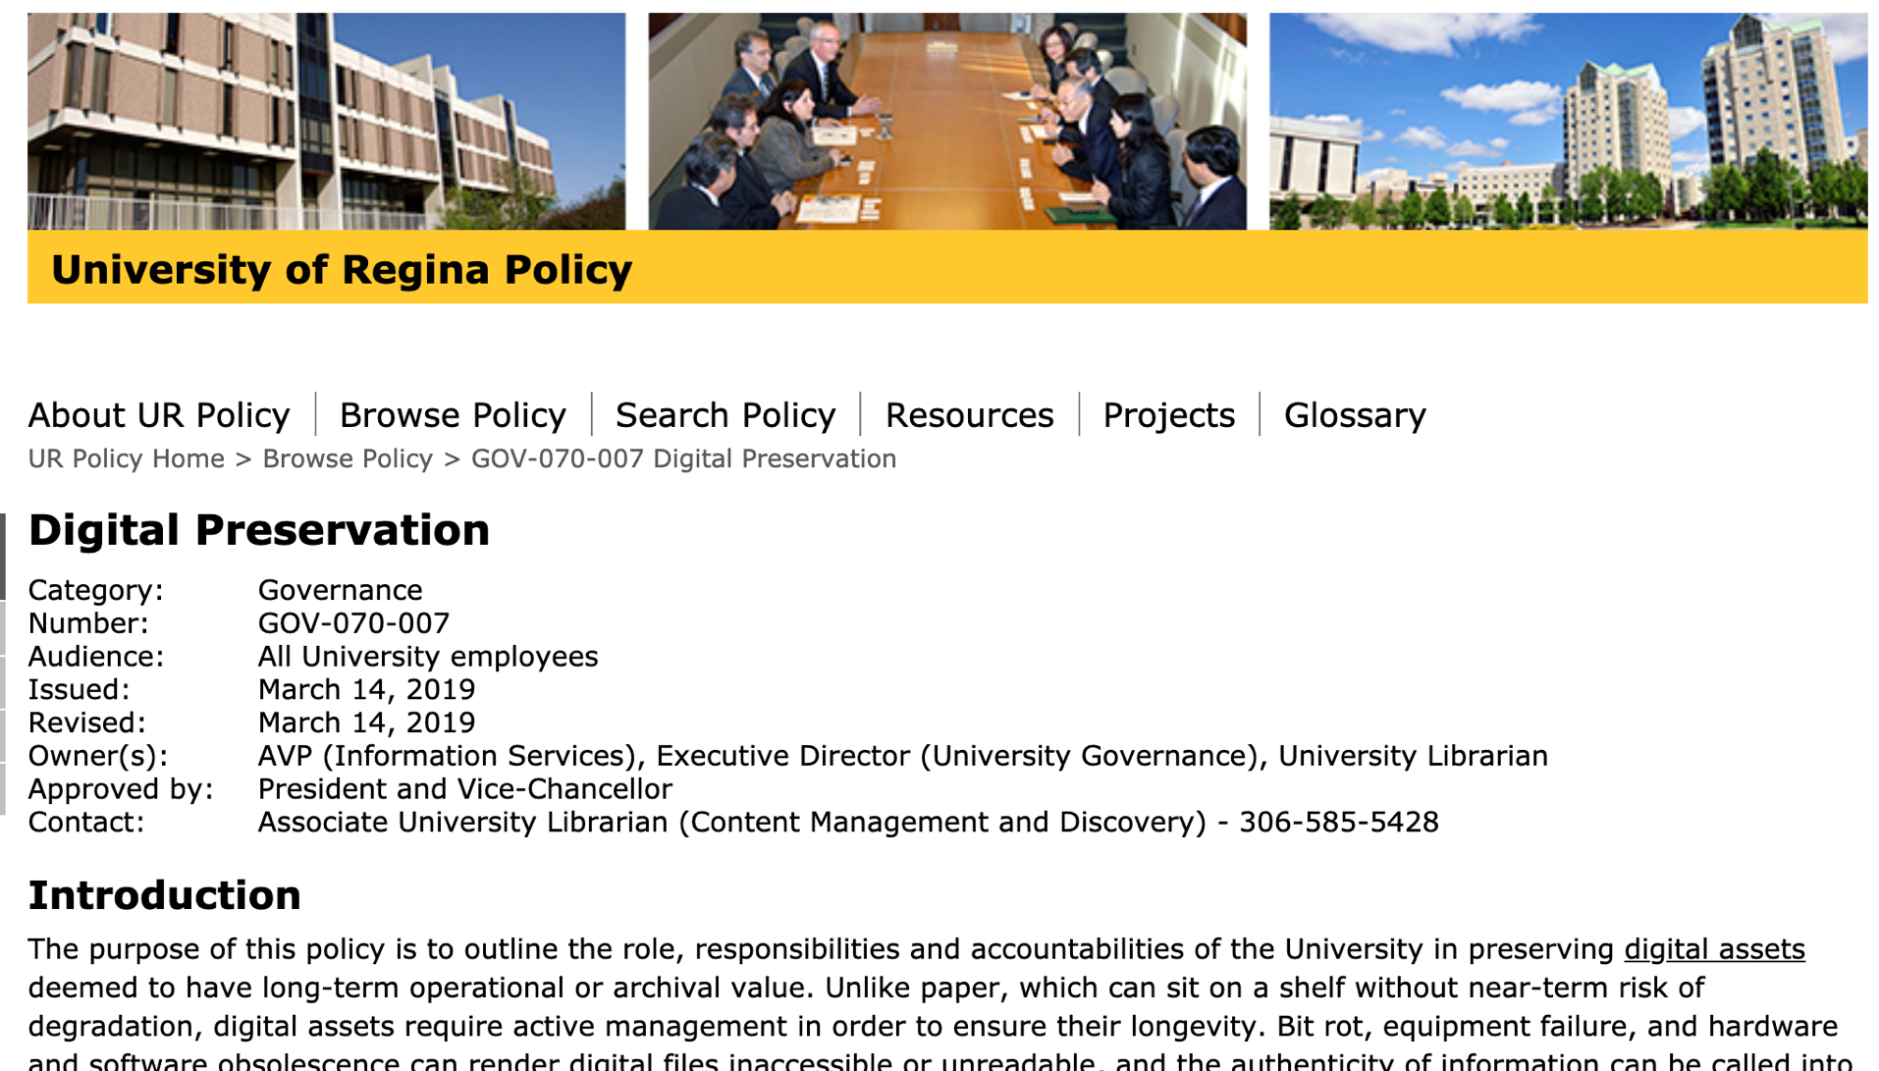

Slide 34
Questions?
dale.storie@uregina.ca

